Slide 1
Emitter Coupled Logic
CSE 211
Lecturer Uzma Hasan, CSE Department, MIST

Slide 2
Introduction
Emitter Coupled Logic or ECL is considered to be a very high-speed logic family
It achieves its high-speed operation by employing a relatively small voltage swing and preventing the transistors from entering the saturation region
Transistors are used in differential amplifier configuration where the emitters of the two transistors are connected and they are never driven into saturation (switched only between cut-off and active regions)
ECL uses negative power supplies (positive end of the supply is connected to GND), in comparison to other logic families in which negative end of the supply is grounded
Positive end of the supply connected to ground. So voltage corresponding to V(0) and V(1) are both negative
Notes:
Emitter coupled as emitters of the two transistors are connected

Slide 3
Introduction
Emitter followers are used for d.c. level shifting of the outputs. They also provide a high input impedance and a low output impedance and causes a large fan out.
Operates on the principle of current switching (current-mode logic) where a fixed bias current less than Ic (sat) is switched from one transistor’s collector to another
In a basic ECL, there are 2 outputs Vc1 and Vc2. The outputs are complement of each other
In ECL, propagation delay is less than 1ns and it’s used in applications where very high speed is needed
Notes:
Emitter Followers: an emitter follower is the same as common collector. In a emitter follower configuration the input is the base and the collector goes to a positive supply (in NPN). The output is taken from the emitter . The output basically follows the input voltage which is on the base except for a 0.7/0.8 volt drop of the base emitter junction. However you also have the current gain of the transistor (beta) so that the output impedance is much lower that that at the base. It allows the signal at the base to drive a much lower impedance.

Slide 4
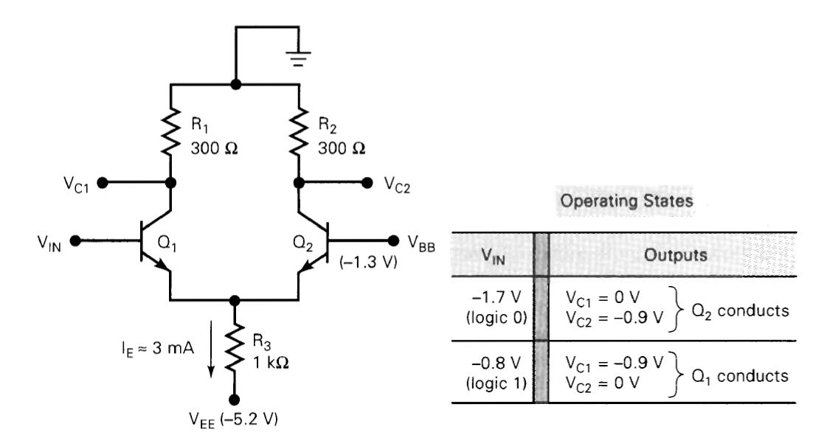
Basic ECL Circuit
Notes:
Emitter coupled as emitters of the two transistors Q1 and Q2 are connected

Slide 5
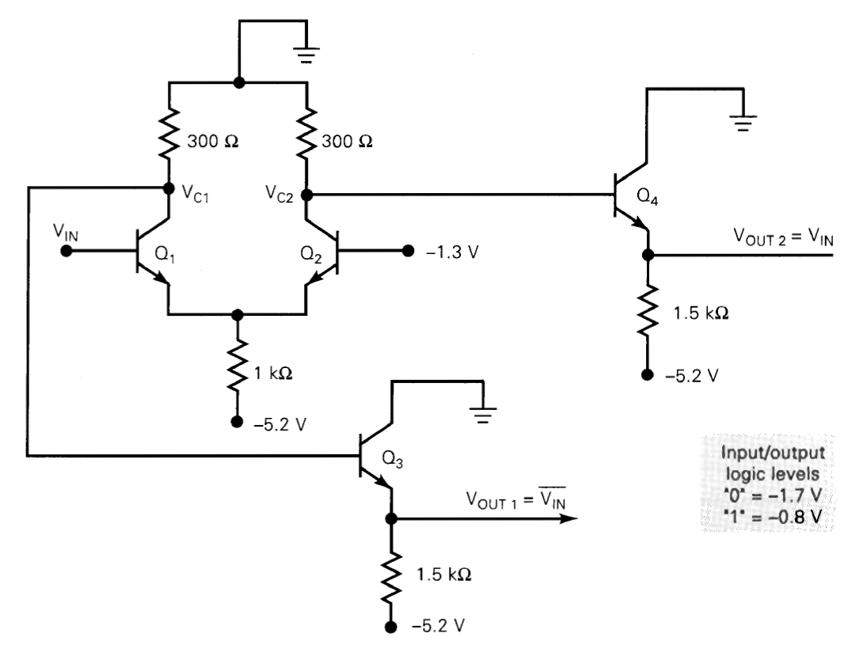
Basic ECL Circuit with Emitter followers
Notes:
Emitter Followers: an emitter follower is the same as common collector. In a emitter follower configuration the input is the base and the collector goes to a positive supply (in NPN). The output is taken from the emitter . The output basically follows the input voltage which is on the base except for a 0.7/0.8 volt drop of the base emitter junction. However you also have the current gain of the transistor (beta) so that the output impedance is much lower that that at the base. It allows the signal at the base to drive a much lower impedance.

Slide 6
Why ECL is faster
The voltage difference between logic high and logic low of an ECL gate is much less than that of a CMOS or TTL logic gate. This low voltage difference reduces the time required to make a transition from logic high to logic low or vice versa.
In addition to the low voltage difference between the logic levels, there’s another mechanism that significantly contributes to the high speed operation of an ECL gate. The trick is to prevent bipolar transistors from entering the saturation region. Turning off a saturated bipolar transistor requires removing or recombining some carriers generated in the transistor base.

Slide 7
Why ECL is faster
If we apply a high to low transition to the input of a saturated BJT, the transistor output won’t change until the charge in the base is removed. This introduces an extra delay, called storage time, to the operation of a BJT employed as a switch. After the storage time, the transistor comes out of saturation and the output of the transistor starts to respond to the input.
When appropriate resistor values are chosen, ECL logic prevents transistors from entering saturation region.

Slide 8
Why ECL uses negative power supply
Noise immunity was the main reason for using a negative power supply with the early ECL gates.
It is done mainly to minimize the influence of the power supply variations on the logic levels as ECL is more sensitive to noise on the Vcc and relatively immune to noise on VEE
Because the analysis of the ECL inverter shows, the output voltages of an ECL gate depend on the value of VCC. For example, the logic high is equal to VCC −VBE, where VBE is the base-emitter voltage drop of the emitter followers. The logic low is VCC−VBE−Vgate, where Vgate is the voltage difference between logic high and low, which is determined by the value of the resistors. Therefore, any noise on VCC will directly affect the ECL gate’s output voltages.
Moreover, it is generally easier to achieve a stable, low-noise ground node than a stable, low-noise power-supply voltage. The early ECL families used a negative supply, and ground was used as the reference for the gate’s output voltages; this led to better noise immunity.

Slide 9
Why ECL uses negative power supply
Alternative explanation: ECL outputs are referenced to the most positive supply rail. This means that any noise appearing on the most positive supply rail will be directly coupled onto the output signal. For example, if the power supply is 5V and GND, then all outputs would be referenced to 5V, and any noise on the 5V supply would also be seen at the ECL outputs. Therefore, the older literature calls for ECL chips to be powered by a negative power supply, such as -5V and GND. By using GND as the most positive supply rail, it is easier to maintain cleaner signals at the ECL outputs. GND is generally found to be less noisy as compared to a non-GND potential. This does not mean it is impossible to use a positive power supply. It does mean that precautions must be taken to ensure very little noise is coupled onto the most positive supply rail in order to maintain clean outputs

Slide 10
ECL Summary
1. Typical propagation delay time is 360 ps, which makes ECL faster than any TTL or CMOS family members. 2. The logic levels are nominally -0.8 V and -1.7 V for the logical 1 and 0, respectively. 3. An ECL logic block usually produces an output and its complement. This eliminates the need for inverters. 5. Fan-out is typically around 25, owing to the low-impedance emitter-follower outputs. 6. The total current flow in an ECL circuit remains relatively constant regardless of its logic state. This helps to maintain an unvarying current drain on the power supply even during switching transitions. Thus, no noise spikes will be generated internally like those produced by TTL and CMOS switching.
7. Typical power dissipation is 25 mW. ECL requires significantly more power than those of other logic families and this is a major disadvantage of ECL.

Slide 11
REFERENCES
1. Class Lectures and Slide
2. Read circuit explanation from book “Digital Systems Principles and Applications (8th edition)”
Chapter 8 - Section 8-15 Page ( 470 – 471 )

Slide 12
THANKYOU

